Slide 1
Basic Electronics Engineering FE 2024 Course
Presented by
Mr. Aniruddha Nirmal
Assistant Professor
Department of First Year Engineering
DPCOE Pune

Slide 2
Unit II : Transistors And Technology
Syllabus
Bipolar Junction Transistor (BJT):
Construction, type, Operation
V-I Characteristics
Region of operation
BJT as switch and CE amplifier
Enhancement Metal Oxide Semiconductor Field Effect Transistors (EMOSFET):
Construction, Types, Operation
V-I characteristics
Regions of operation
MOSFET as switch & amplifier.

Slide 3
Contents
Transistor (BJT) Structure
Transistor characteristics and parameters
Transistor as an amplifier
Transistor as a switch
EMOSFET

Slide 4
Introduction
The semiconductor device like a diode cannot amplify a signal, therefore its application area is limited.
The next development of semiconductor device after diode is a BJT (bipolar junction transistor).
It is a three terminal device. The terminals are – collector, emitter, and base. Out of which the base is a control terminal.
A signal of small amplitude applied to the base is available in the “magnified” form at the collector of the transistor.
Thus the large power signal is obtained from a small power signal.

Slide 5
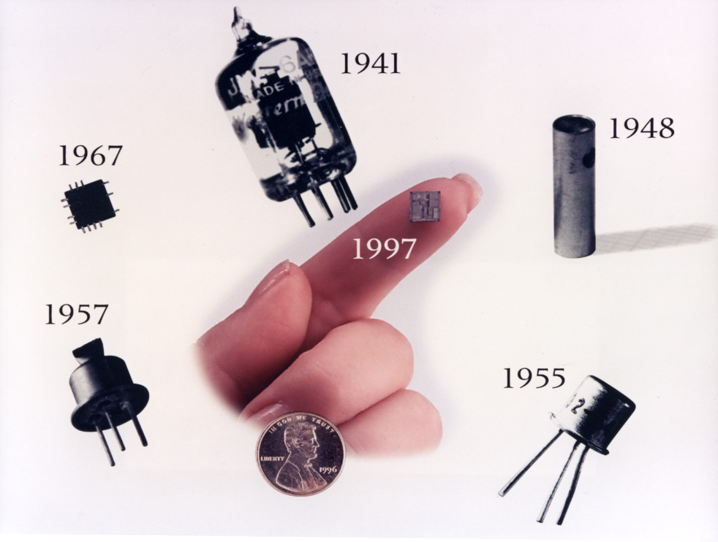
History of Transistors
1948 – The year of establishment of E&TC - COEP
http://www.bellsystemmemorial.com/belllabs_transistor.html

Slide 6
Why is it called transistor ?
The term transistor was derived from the words TRANSFER & RESISTOR.
Transfers input signal current from a low resistance path to a high resistance path.

Slide 7
N-P-N transistor
C
C
Collector
N
Collector Base
Junction J_{C}
P
B
B
Base
N
Emitter Base
Junction J_{E}
E
Emitter
E

Slide 8
The BJT – Bipolar Junction Transistor
npn
pnp
n
p
n
p
n
p
E
C
E
C
Cross Section
C
Cross Section
C
B
B
B
B
Schematic Symbol
Schematic Symbol
E
E
Normally Emitter layer is heavily doped, Base layer is lightly doped and Collector layer has Moderate doping.

Slide 9
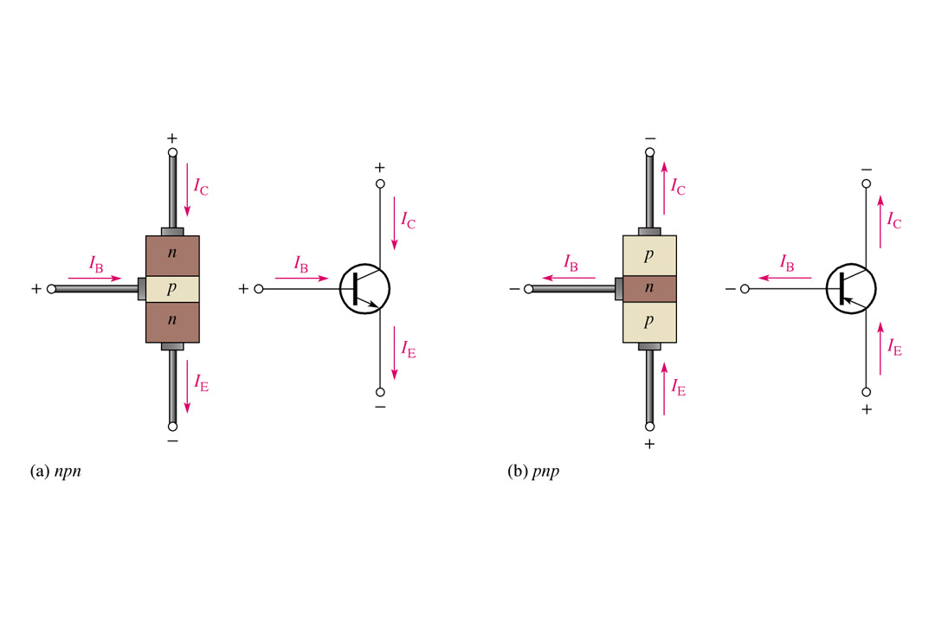
transistor currents
Collector Base
Junction J_{C}
P
B
B
Base
N
Emitter Base
Junction J_{E}
E
Emitter
E

Slide 10
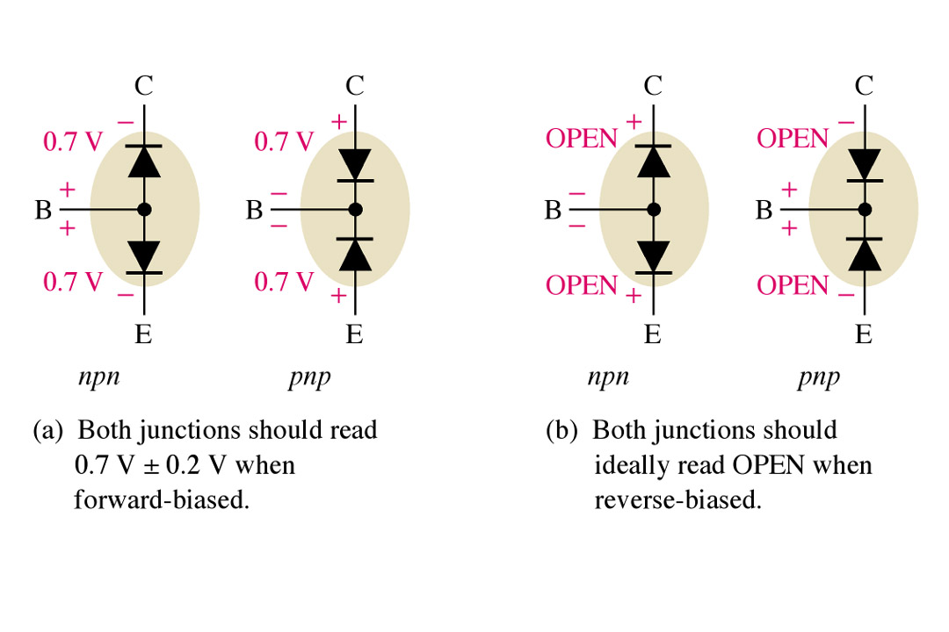
Number of P-N junctions and equivalent circuit
E
Emitter
N
E
P
P
B
Base
B
B
N
C
C
Collector

Slide 11
An unbiased Transistor – Depletion region
For an unbiased transistor no external power supplies are connected to it
Base
Junction
J_{EB}
Junction
J_{CB}
+
-
-
-
-
+
+
-
-
-
-
+
collector
Emitter
N
+
-
-
P
-
-
+
N
+
-
-
-
-
+
+
-
-
-
-
+
Depletion
region
Depletion
region

Slide 12
Transistor biasing in the active region
Sr.No. | Region of operation | Base emitter junction | Collector base junction | application
1 | Cutoff region | Reverse biased | Reverse biased | transistor is OFF
2 | Saturation region | Forward biased | Forward biased | transistor is ON
3 | Active region | Forward biased | Reverse biased | Amplifier

Slide 13
Transistor operation in the active region P-N-P
Junction
JEB
Junction
JCB
P
N
P
Emitter
collector
N
P
holes emitted
holes collected
RE
RC
conventional
current
+
-
Base
+
-
Conventional
current
V_{EE}
IE = IC + IB
V_{CC}

Slide 14
Transistor configuration
Depending on which terminal is made common to input and output port there are three possible configurations of the transistor. They are as follows:
Common base configuration
Common emitter configuration
Common collector configuration

Slide 15
Transistor operation in the active region N-P-N common base configuration
Junction
JEB
Junction
JCB
Emitter
collector
N
P
N
Electron emitted
Electron collected
(injected collector current)
RC
RE
Direction
Conventional
Current IB
Direction
Conventional
Current IE
Direction
Conventional
Current IC (INJ)
-
+
-
+
Base
Emitter electron
current
V_{EE}
V_{CC}

Slide 16
Transistor operation in the active region N-P-N common base configuration
JEB
JCB
+
-
-
-
-
+
+
-
-
-
-
+
collector
Emitter
N
+
-
-
-
-
+
N
+
-
-
-
-
+
+
-
-
P
-
-
+
Depletion
region
Depletion
region
RC
ICBO is a reverse saturation
Current flowing due to the
Minority carriers between
Collector and base when the
Emitter is open. ICBO flows due to the reverse
Biased collector base junction.
I_{CBO} is neglected as compared to IC
IC=ICBO
V_{CC}
-
+
Base
I_{CBO}
Is a collector to base leakage current
With open emitter

Slide 17
Current relations in CB configuration
Current amplification factor ( α_{dc})
the current amplification factor is the ratio of collector current due to the injection of total emitter current
I_{C} = I_{C(INJ)} + I_{CBO}
α_{dc} = I_{C(INJ)} / I_{E}
I_{C(INJ)} = α_{dc} I_{E}
But I_{CBO} is negligibly small
Therefore the current amplification factor
IC = αdcIE + ICBO
IC = αdcIE
αdc= IC / IE

Slide 18
Characteristics of a transistor in CB configuration
Input characteristics
VCB
8V
VCB
4V
IE
C
IE
E
N
P
N
-
+
RE
VBE
JE
JC
+
VCB =8V
ΔIE
-
+
-
B
VEE
IE
VBE
E
C
ΔVBE
-
+
RE
VBE
Input resistance
Ri = ΔVBE / ΔIE
+
VCB =8V
-
+
-
As the change in emitter current is very large for a
Small change in input voltage, the input resistance
Ri is small
VEE
B

Slide 19
Characteristics of a transistor in CB configuration
“Early effect” or “base width modulation”.
zero effective base width
At larger values of VCB
Wider Depletion
Region for larger values of VCB
JE
JC
-
-
-
-
-
-
+
-
-
-
-
-
-
+
collector
Emitter
-
-
-
-
-
-
+
Emitter
N
Base
P
Collector
N
-
-
-
-
-
-
+
-
-
-
-
-
-
+
Total base width
VCB increases extremely
For extremely large VCB the effective base width may be reduced to zero, causing voltage breakdown of a transistor.
This phenomenon is known as punch through

Slide 20
Characteristics of a transistor in CB configuration
Output characteristics
IC
(mA)
Constant
IE=3mA
Active region
(high output dynamic
resistance)
IC
C
E
N
P
N
+
3
IE=3 mA
RE
JE
JC
VCB
RC
2
IE=2 mA
-
+
-
+
1
IE=1 mA
IC=ICBO
IE=0
B
VEE
VCC
-1
0
5
10
VCB
Constant IE=3mA
IC
C
Cutoff region
Both the junctions
are reverse biased
E
-
+
VCB
RC
RE
VEB
+
-
saturation region
Both the junctions
are forward biased
-
+
-
+
VEE
B
VCC

Slide 21
Characteristics of a transistor in CB configuration
Transfer characteristics
IC (mA)
VCB constant
4
3
2
1
Slope = ΔIC / ΔIE = αdc
0
1
2 3 4
IE (mA)
α dc = ΔIC / ΔIE

Slide 22
Characteristics of a transistor in CE configuration
Input characteristics
It is a graph of input current (I_{B}) versus input voltage (V_{BE}) at a constant output voltage (V_{CE}).
C
IC
N
IB
(μA)
VCE
constant
VCE = 4V 10V
IB
JC
+
B
P
VCC
ΔIB
JE
N
-
RB
VBE
ΔVBE
Ri=ΔVBE/ΔIB
VCE Constant
VBB
+
IE
0 0.7 1 2
VBE
-
E
The value of dynamic input resistance “Ri” is low for CE
N-P-N Transistor

Slide 23
Characteristics of a transistor in CE configuration
Output characteristics
It is a graph of output current (I_{c}) versus output voltage (V_{CE}) at a constant input current (I_{B})
C
IC
βdc = IC /I_{B}
RE
Saturation
region
Active
region
IC
(mA)
IB = 4μA
+
4
3
2
1
B
IB = 4μA
IB = 3μA
VBE
VCE
-
RB
VCC
IB = 2μA
VBB
+
IE
IB = 0
1 2 3 4
E
VCE
-
N-P-N Transistor
Cutoff region

Slide 24
Characteristics of a transistor in CE configuration
Transfer characteristics
IC (mA)
VCE constant
4
3
2
1
Slope = ΔIC / ΔIB = βac
0
1
2 3 4
IB (μA)
β ac = ΔIC / ΔIB
β dc = IC / IB
VCE constant

Slide 25
Comparison of configurations
Sr. No. | Parameter | CB | CE | CC
1 | Common terminal between input and output | Base | Emitter | Collector
 | Conduction Angle | 0 º | 180 º | 0 º
2 | Input current | I_{E} | I_{B} | I_{B}
3 | Output current | I_{C} | I_{C} | I_{E}
4 | Current gain | α_{DC} = I_{C}/I_{E} _{Less than one} | β_{DC} = I_{C}/I_{B} _{High} | γ = I_{E}/I_{B} _{HIGH}
5 | Input Voltage | V_{eb} | V_{be} | V_{bc}
6 | Output voltage | V_{cb} | V_{ce} | V_{ec}
7 | Current gain | Less than unity | High | High
8 | Input resistance | Very low (20Ω) | Low (1KΩ) | High(500kΩ)
9 | Output resistance | Very high (1M) | High(40kΩ) | Low (50Ω)
10 | Application | As preamplifier | Audio amplifier | Impedance matching
11. | Voltage gain | Medium | Large | Less than 1

Slide 26
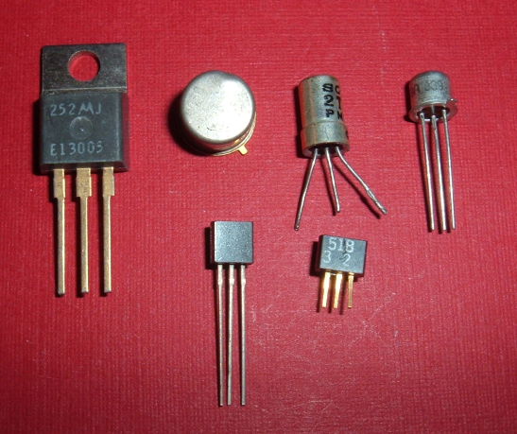
Transistor Biasing
What is meant by dc biasing of a transistor ?
Depending on the application, a transistor is to be operated in any of the three regions of operation namely cutoff, active and saturation region.
To operate the transistor in these regions the two junctions of a transistor should be forward or reverse bias

Slide 27








DC Load Line
I_{C} = [-1/R_{C}] V_{CE} + V_{CC}/R_{C}
and substituting I_{C} = 0 in above equation
V_{CE} = V_{CC} → →or point “B”
C
IC
RC
DC load line
$I_{C} mA$
+
$I_{C}$ max
A
3
2
1
$I_{B}=4μA$
VCE
-
VCC
$I_{B}=3μA$
$I_{B}=2μA$
$I_{B}=0μA$
E
$$V_{CE}$$
N-P-N Transistor
1 2 3 4
B
$$V_{CE}=V_{CC}$$

Slide 28
Typical Junction Voltages
Voltage | Silicon Transistor | Germanium Transistor
VBE (Cut-off) | 0 | -0.1V
VBE (Cut-in) | 0.5v | 0.1V
VBE (Active) | 0.7V | 0.2V
VBE (Saturation) | 0.8V | 0.3V
VCE (Saturation) | 0.2V | 0.1V

Slide 29
Biasing circuits
To avoid a shift of Q-point, bias-stabilization is necessary. Various biasing ckts can be used for this purpose.
Fixed bias
Collector-to-base bias
Self Biased or Voltage divider bias
Fixed bias with emitter resistor
Emitter bias

Slide 30
Single Stage RC Coupled CE Amplifier
+V_{CC}
C1 & C2 are Coupling Capacitors
R1 & R2 are Biasing Resistor
R₁
R_{C}
C₂
V_{O}
Amplified signal
output Signal
C₁
V_{i}
Signal to be
Amplified
R_{L}
R₂
R_{E}
C_{E}
Bypass Capacitor

Slide 31
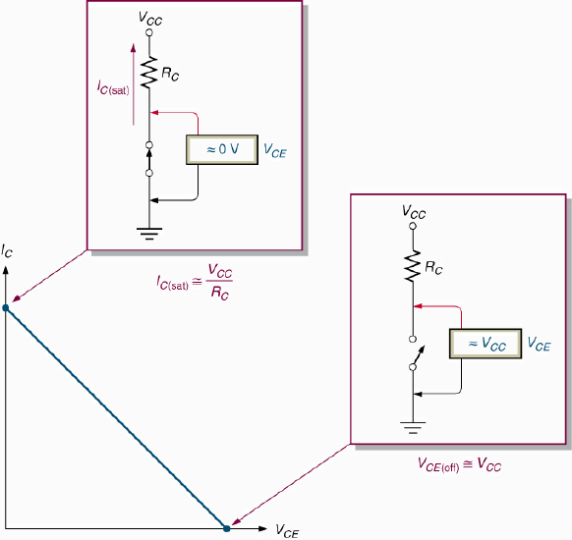
BJT Switch
When operated in saturation, the BJT acts as a closed switch.
When operated in cutoff, the BJT acts as an open switch.

Slide 32
MOSFET FIELD-EFFECT TRANSISTORS ( FET)
FETs are the uni polar devices because, unlike BJTs that use both electron and hole current, they operate only with one type of charge carrier.
The two main types of FET’s are -
Junction Field Fffect Transistor (JFET) and
Metal Oxide Semiconductor Field Effect Transistor (MOSFET)

Slide 33
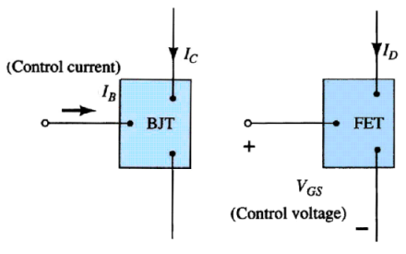
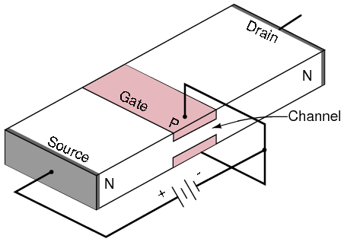
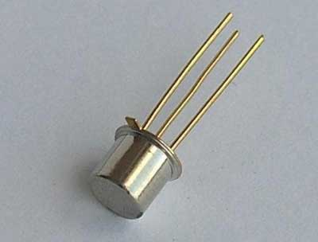
Current Controlled & Voltage Controlled Devices

Slide 34
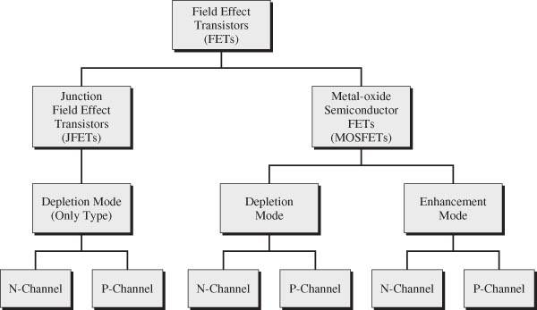
Field Effect Transistors - Classification

Slide 35
MOSFET (IGFET)
The MOSFET (metal oxide semiconductor field effect transistor) is the category of FET.
The MOSFET differs from the JFET in that it has no PN junction structure; instead, the gate of the MOSFET is insulated from the channel by a silicon dioxide (Sio2) layer.
Two basic types of MOSFETS are :
Depletion ( D ) MOSFET and
Enhancement ( E ) MOSFET
Because of the insulated gate, these devices are also called as IGFET.

Slide 36
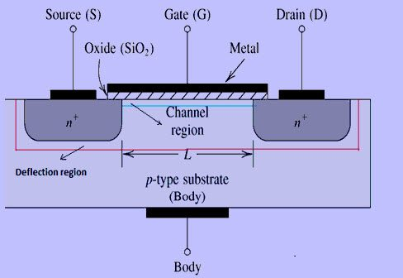
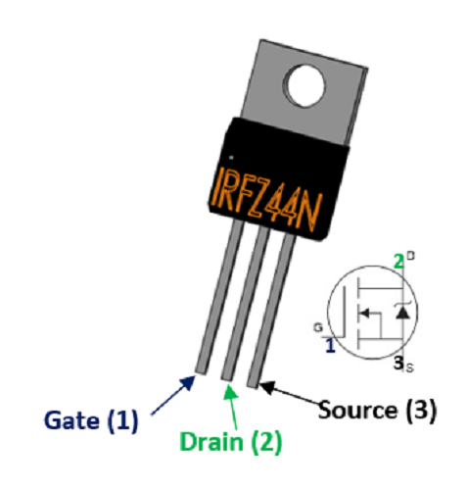
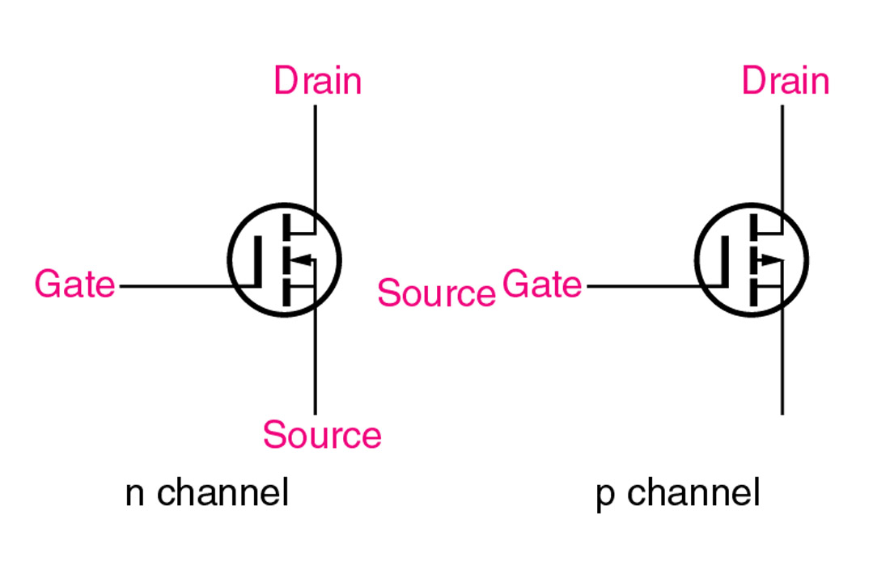

ENHANCEMENT MOSFET ( E-MOSFET)
MOSFET was invented by Atalla & Dawon at Bell Labs in 1959

Slide 37
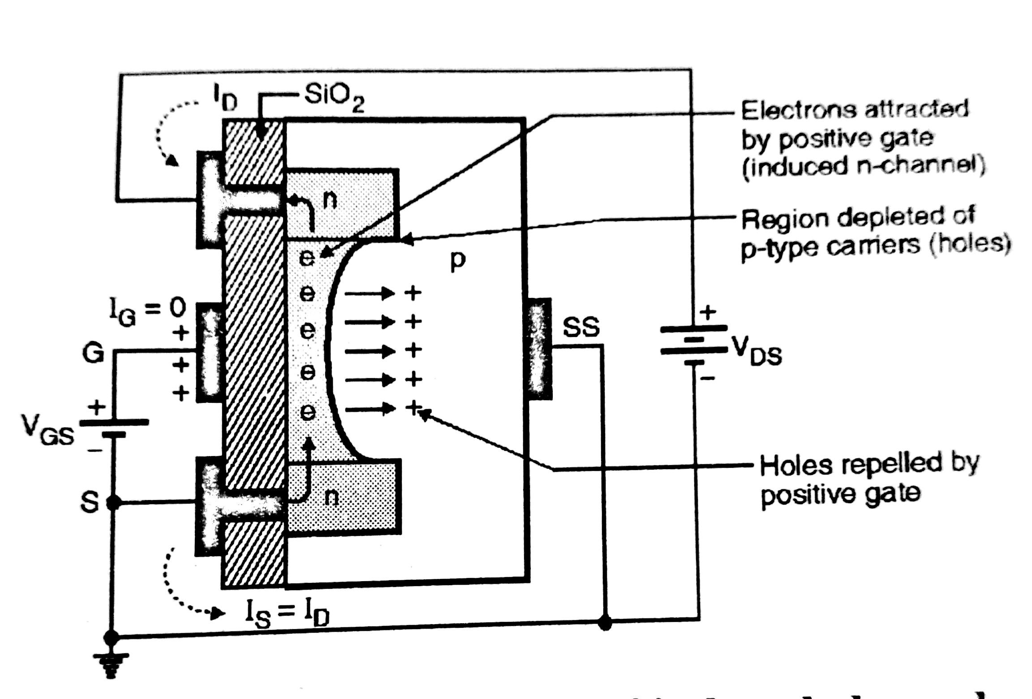
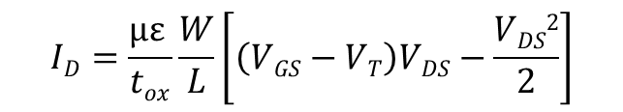

Linear & Saturation Regions

Slide 38
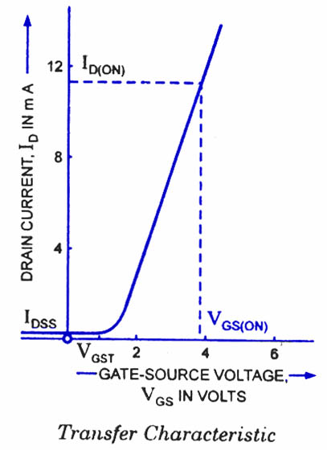
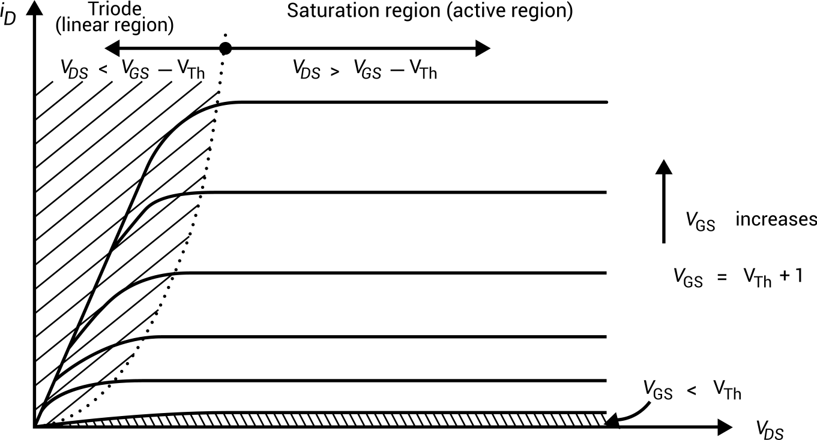
Transfer & Drain Characteristics

Slide 39
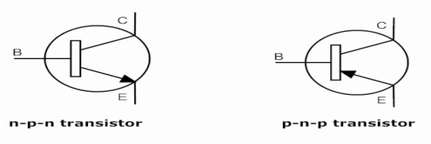
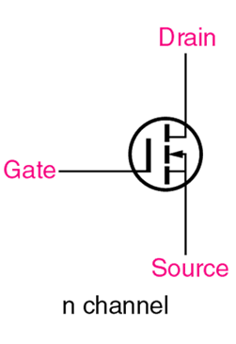
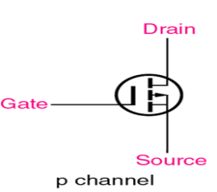
BJT | MOSFET
It is a current controlled device. | It is a voltage controlled device.
It is a bipolar device (Current flows due to both majority & minority carriers). | It is a unipolar device (Current flows due to only majority carriers).
Thermal Runaway can damage the BJT | Thermal Runaway does not take place
Input resistance (R_{i}) is very low. | Output resistance (R_{o}) is very high.
Transfer characteristics are linear in nature. | Transfer characteristics are non-linear in nature.
BJT is More sensitive than MOSFET | MOSFET is less Sensitive
AC Voltage Gain is HIGH | AC Voltage Gain is Less
Bigger in size. | Smaller in size.
Regions of operation: Saturation – ON Switch , Cut off – OFF Switch Active – Amplifier | Regions of operation: Ohmic – ON Switch ,Saturation – Amplifier , Cut off – OFF Switch
It is more noisy. | It is less noisy.
Switching speed is less. | Switching speed is high.
Symbol | Symbol

Slide 40
Conclusion
Read the Instruction Manuals of equipment i.e. Car, Washing m/c, Microwave oven, Cell phone, Laptop etc.
BJT is used rarely.
MOSFET is matured technology & used everywhere.
MOSFET ckts have low dissipations, high swing & integration.
Device / Ckt / Chip / Application designers are well respected. Less effect of recession.

Slide 41
THANK YOU

